Slide 1


ELLEHACKS 2024
Bug Hunters:
Jasmin, Jessica, Misheel, Subin

Slide 2

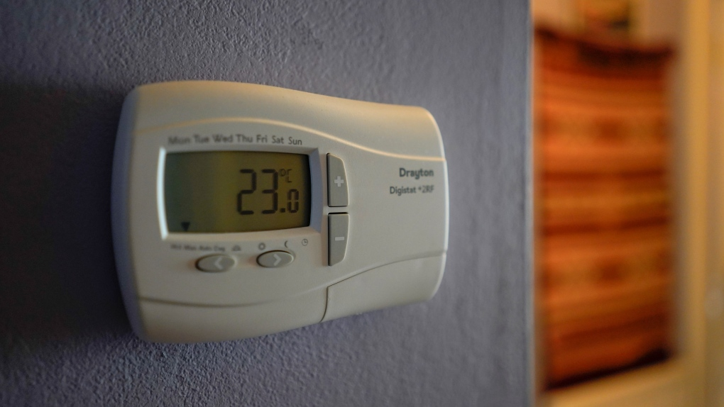
Current Issue
Notes:
A thermostat in the house of Sharron Anderson, 60, in Plumstead, London, Thursday, Sept. 8, 2022. (AP Photo/Alberto Pezzali)

Slide 3
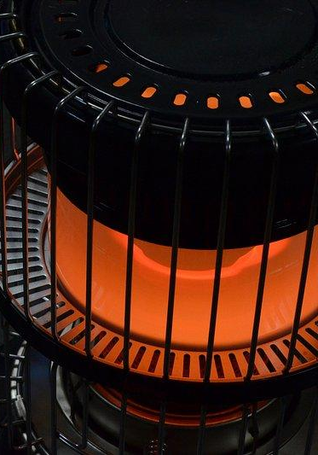

Heating Cost in Winter
Central heating rates are becoming incredibly expensive and financially unsustainable
Notes:
Explain the problem, especially mentioning rising heating costs in the winger

Slide 4


“In 2019, the average Ontario household spent $2,128 on home energy”
(Gurnham & Devakos, 2021, p.1)
4.6 per cent (Lowest income)
1.2 per cent
(Highest income)
(Gurnham & Devakos, 2021, p.1)
1.
2.
3.
Differences in electricity subsidies depending on income
(Gurnham & Devakos, 2021, p.1)
Notes:
Gurnham & Devakos from the Financial Accountability Office of Ontario: https://www.fao-on.org/en/Blog/Publications/home-energy-2021

Slide 5
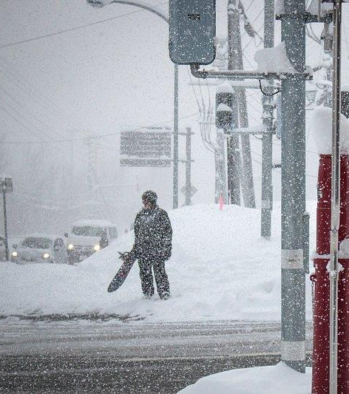
Why Are Heating Costs Especially High in the Winter?
Natural gas is our main source of energy
More expensive in the Winter months
(Natural gas rates, n.d)
Notes:
How are rates affected by a change in the seasons? Why in winter? natural gas is a main source of heating in North America, it is usually more expensive in the winter months.

Slide 6

Our Solution

Slide 7

Calculating User Heating Costs
Review the information given by the user and offer suggestion on how to lower heating costs
Notes:
Once this is calculated, we review the information given by the user and offer suggestions on how to lower heating costs. We then provide a before and after comparison of the costs.

Slide 8
Calculate Required BTUs
Number of Square Feet * Temperature difference factor * Insulation factor
= 0.2(Difference Factor) + (Outdoor Temperature - Desired Indoor Temperature)

Slide 9
2. Calculate Price
Gas Rate
Utility Name | Gas Supply Charge
Enbridge Gas Inc. - Union South Rate Zone* | 19.2506 ¢/m³
Enbridge Gas Inc. - Union North East Rate Zone** | 18.2917 ¢/m³
Enbridge Gas Inc. - Union North West Rate Zone | 11.4990 ¢/m³
Enbridge Gas Inc. | 13.7883 ¢/m³
EPCOR Natural Gas Limited Partnership (Aylmer)*** | 20.8848 ¢/m³
EPCOR Natural Gas Limited Partnership (South Bruce) | 15.4105 ¢/m³
(Hydro one, n,d,)
Notes:
Reflects the cost of producing electricity at different times of day based on demand: on-peak, mid-peak, off-peak.
On-peek (7am-11am, 5pm-7pm)
Mid-peak (11am-5pm)
Off-peak (7pm-7am)
Time of use Price Periods is one of the electricity companies options
- Off-peak, when demand for electricity is generally lower. Ontario households use most of their electricity – nearly two thirds of it – during off-peak hours.
- Mid-peak, when demand for electricity is moderate. These periods are during the daytime, but not the busiest times of day.
- On-peak, when demand for electricity is generally higher. These are the busier times of day – generally when people are cooking, starting up their personal electronics and running heaters or air conditioners.

Slide 10
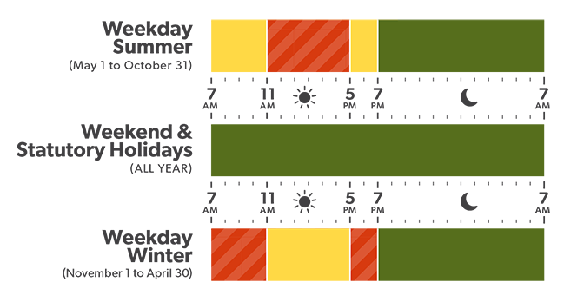
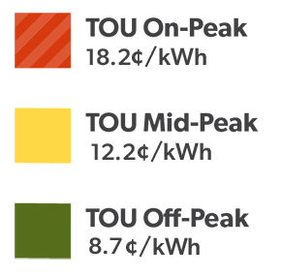

Time Of Use Price Plan (TOU)
2. Calculate Price
Electricity Rate
For majority of customers
(Hydro one, n,d,)
Notes:
Reflects the cost of producing electricity at different times of day based on demand: on-peak, mid-peak, off-peak.
On-peek (7am-11am, 5pm-7pm)
Mid-peak (11am-5pm)
Off-peak (7pm-7am)
Time of use Price Periods is one of the electricity companies options
- Off-peak, when demand for electricity is generally lower. Ontario households use most of their electricity – nearly two thirds of it – during off-peak hours.
- Mid-peak, when demand for electricity is moderate. These periods are during the daytime, but not the busiest times of day.
- On-peak, when demand for electricity is generally higher. These are the busier times of day – generally when people are cooking, starting up their personal electronics and running heaters or air conditioners.

Slide 11
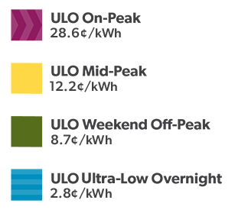
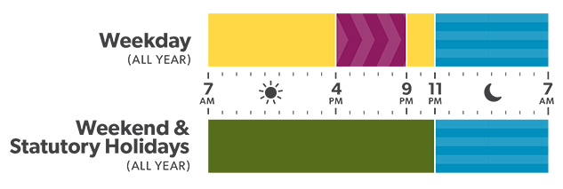
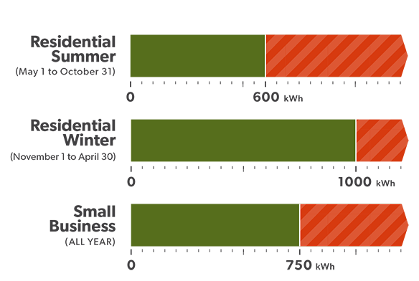
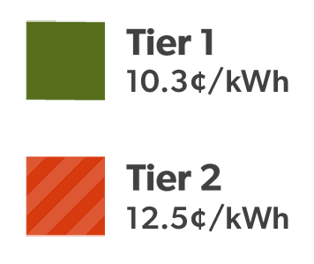
Ultra Low Overnight Price Plan (ULO)
Tiered Price Plan (RPP)
For customers who use more electricity at night and charge their electric vehicle
For customers without smart meter in certain rural areas

Slide 12
Apply for the Ontario Electricity Support Program
First
Suggestions
Low-emissivity Coatings and Insulated Frames for Windows
Second

Slide 13

Code Demo

Slide 14

Future Developments
Our solution can be expanded to include more electrical companies data and update suggested actions.

Slide 15

THANK YOU!
Any questions?

Slide 16
SOURCES
BTU Calculator Canada. (n.d.). Aerotech Herman Nelson. Retrieved February 17, 2024, from https://hermannelson.com/btu-calculator-canada/
Bill calculator | Ontario Energy Board. (n.d.). Www.oeb.ca. Retrieved February 17, 2024, from https://www.oeb.ca/consumer-information-and-protection/bill-calculator
Decoding Toronto’s Utility Bills: Costs and Cutting Corners. (2023, Sept. 26). Www.pine.ca. Retrieved February 17, 2024, from https://www.pine.ca/blog/decoding-torontos-utility-bills-costs-and-cutting-corners
Digest, W. (2023, July 3). Window Sealing for Improved Efficiency: A DIY Guide. Window Digest. https://windowdigest.com/window-sealing-for-improved-efficiency-a-diy-guide/#benefits-of-improved-efficiency
Electricity rates | Ontario Energy Board. (n.d.). Www.oeb.ca. https://www.oeb.ca/consumer-information-and-protection/electricity-rates#current
EPCOR NATURAL GAS LIMITED PARTNERSHIP. (2023, Dec. 19). https://www.oeb.ca/sites/default/files/backgrounder-qram-epcor-20231219-en.pdf
Gurnham, M., & Devakos, T. (2021, Oct. 19). “Home Energy Spending in Ontario: Income and Regional Distribution.” Financial Accountability Office of Ontario (FAO). Retrieved February 17, 2024, from https://www.fao-on.org/en/Blog/Publications/home-energy-2021

Slide 17
SOURCES
Hydro One. (n.d.). Www.hydroone.com. Retrieved February 17, 2024, from https://www.hydroone.com/rates-and-billing/rates-and-charges/electricity-pricing-and-costs#TOU
Heating Degree Days (18°C) - Annual data for Toronto. (n.d.). Amateur Weather Statistics for Toronto, Ontario. https://toronto.weatherstats.ca/charts/hdd-yearly.html
Hydro One Networks Inc. TARIFF OF RATES AND CHARGES Effective and Implementation Date. (2024, Dec. 14). https://www.hydroone.com/abouthydroone/RegulatoryInformation/rateschedules/Documents/2024_Rate_Schedules.pdf
Insulation Calculator. (n.d.). The Home Depot. Retrieved February 17, 2024, from https://secure2.homedepot.com/account/view/calculator/insulation
Limited, HydroOttowa. (n.d.). Electricity Rate Selection | Hydro Ottawa. Hydroottawa.com. https://hydroottawa.com/en/accounts-services/accounts/electricity-rate-selection
Natural gas rates | Ontario Energy Board. (n.d.). Www.oeb.ca. Retrieved February 17, 2024, from https://www.oeb.ca/consumer-information-and-protection/natural-gas-rates#seasons
Residential electricity rates - Toronto Hydro. (2019). Torontohydro.com. https://www.torontohydro.com/for-home/rates
Residential Electricity Rates | Elexicon Energy Inc. (n.d.). Elexiconenergy.com. Retrieved February 17, 2024, from https://elexiconenergy.com/for-home/account-billing/rates

Slide 18
SOURCES
Residential Natural Gas Rates | Enbridge Gas. (n.d.). Www.enbridgegas.com. Retrieved February 18, 2024, from https://www.enbridgegas.com/en/residential/my-account/rates
R-Value of Building Materials. (n.d.). Alaska Housing Finance Corporation. Retrieved February 17, 2024, from https://www.ahfc.us/iceimages/manuals/building_manual_ap_1.pdf
Select Ontario Electricity Provider. (n.d.). EnergyRates.ca. Retrieved February 17, 2024, from https://energyrates.ca/select-ontario-electricity-provider/?prefix=m3j&plan=residential
Toronto: Cost of Living, Salaries, Prices for Rent & food. (2024, Feb. 10). Livingcost.org. Retrieved February 17, 2024, from https://livingcost.org/cost/canada/on/toronto‌
Time-of-Use Pricing. (n.d.). Alectra Utilities. https://alectrautilities.com/time-use-pricing
Types of Insulation and R-Value Insulation Chart. (n.d.). The Home Depot. Retrieved February 17, 2024, from https://www.homedepot.ca/en/home/ideas-how-to/home-repair-and-maintenance/how-to-choose-insulation.html
Types of Insulation. (2019). The Home Depot. Retrieved February 17, 2024, from https://www.homedepot.com/c/ab/types-of-insulation/9ba683603be9fa5395fab902f82532f
Presentation format from Slidesgo

Slide 19
IMAGES
Lunato, T. (2019, January 30). 5 Tips for Working on Group Projects. Herzing University. https://www.herzing.edu/blog/5-tips-working-group-projects
https://img.freepik.com/free-vector/tiny-business-person-career-directions-opportunities-female-character-with-plans-future-job-positive-vision-flat-vector-illustration-success-strategy-life-goal-concept-banner_74855-22562.jpg
11 Hacks To Help You Save On Heating This Winter. (2021, July 12). GEICO Living. https://living.geico.com/saving/money/how-to-slash-your-heating-bill/
calculate pictures - Google Search. (n.d.). Www.google.com. Retrieved February 18, 2024, from https://www.google.com/search?q=calculate+pictures&tbm=isch#imgrc=ujEeUz8WcZTr4M
Energy Consumption free icons designed by Freepik. (n.d.). Flaticon. Retrieved February 18, 2024, from https://www.flaticon.com/free-icon/energy-consumption_2959609
Inflation calculator. (n.d.). Www.ons.gov.uk. https://www.ons.gov.uk/visualisations/dvc1833/calculator/index.html
Hydro One. (n.d.). Www.hydroone.com. https://www.hydroone.com/rates-and-billing/rates-and-charges/electricity-pricing-and-costs#TOU

